Slide 1
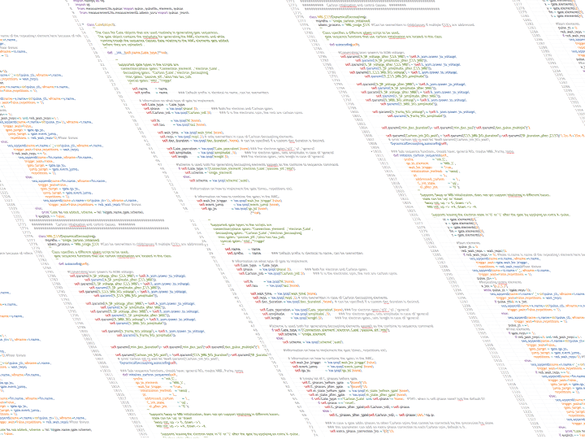
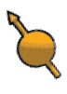
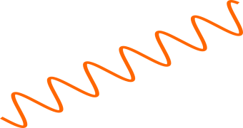
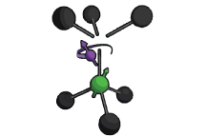

Parity Measurements on Weakly Coupled Carbon Spins in Diamond

Slide 2
Action title relating to next chapter
The promise of the quantum computer
Quantum Error Correction and the Parity Measurement
The Nitrogen Vacancy Center in Diamond
Controlling Weakly Coupled Carbon Spins
The Parity Measurement
Towards Quantum Error Correction
Here some visual about the next section

Slide 3
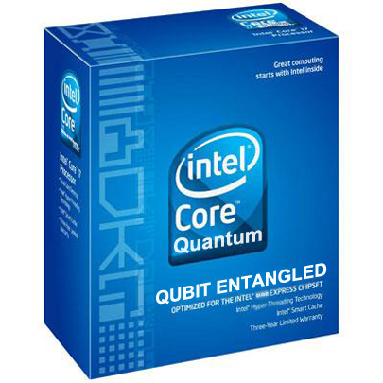
A Quantum Computer promises an exponential speedup over conventional computers

Slide 4

A qubit is the quantum analogue of the classical bit
Classical Bits vs Quantum Bits
Bit
Qubit
0
1
What’s different?
Wavefunction Collapse (Can only measure along one axis) ->
Entanglement (multi-qubit)
Essential, Explain rotation
Explain Rotation of qubits

Slide 5
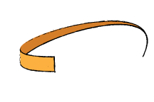
A Qubit differs from a classical bit on three important characteristics
Direction of the arrow contains information and precesses
A measurement projects
Multiple Qubits can Entangle
Decoherence not in here yet

Slide 6
When you measure a qubit it gets projected

Slide 7
Quantum Error Correction is essential in building a scalable quantum computer
What happens if we make an error ?
Errors are a Problem
Classical -> Errors Average out
Quantum -> Errors add up
Classicaly we correct it
Can we do that quantum?
Because errors add up need to correct
Classical Error correction -> Majority voting
Classical Error Correction does not work
-No Cloning -> Prevents destroying clones
- Wave function collapse

Slide 8
By measuring the parity an Error can be diagnosed and corrected
Encode
Diagnose
Correct
NOTE: No entanglement explained yet, do I need it ?

Slide 9
The NV-center is a promising candidate for quantum computation
Node based architecture
Combination of optical and solid state qubits

Slide 10

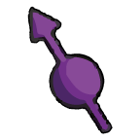
The NV-center is an impurity in Diamond which we can control
afs
Optical Readout
MW spin control
Notes:
Slide Showing optical Readout
Arrow up -> photon out
Arrow down-> no response
MW control, can turn purple spin around. (rotate the spin).

Slide 11
We can use the optical interface to link multiple NV-centers together
Optical Interface allows linking of nodes
Well protected local qubits in solid state environment

Slide 12
The Nitrogen Vacancy interacts with spins in its environment
-> Decoherence

Slide 13
We Address Weakly Coupled Carbons in order to find enough suitable qubits
REQUIRES DECOHERENCE
The

Slide 14
We Perform a Parity Measurement by Mapping the State of the Carbon on the electron

Slide 15
In Order to Implement Quantum Error Correction we need to be correct the outcome of a parity measurement

